Slide 1
READER’S HUB ~LMS
JAYANTH MADHU KIRAN
(11702425) (11702928)
PRASANNA REDDY SUMATHI
(11705233) (11701968)

Slide 2
CONTENTS
INTRODUCTION
FEATURES
WORK ALLOCATION
DESIGN OF OUR WEBSITES
CONCLUSION

Slide 3
INTRODUCTION
Library is the place where people go and study
We have designed the project so that people can access the different types of books available in library

Slide 4
FEATURES
100% responsive
Unique design
Easily accessible
Clean and clear structure
Designed in view of students

Slide 5
Work allocation
Jayanth :login page , mathematics
page, page joining login and signup page.
Sumathi : physics page, library rules
Prasanna: sign-up page , returning books , homepage joining all other web pages.
Madhu: issuing books , mechanics

Slide 6
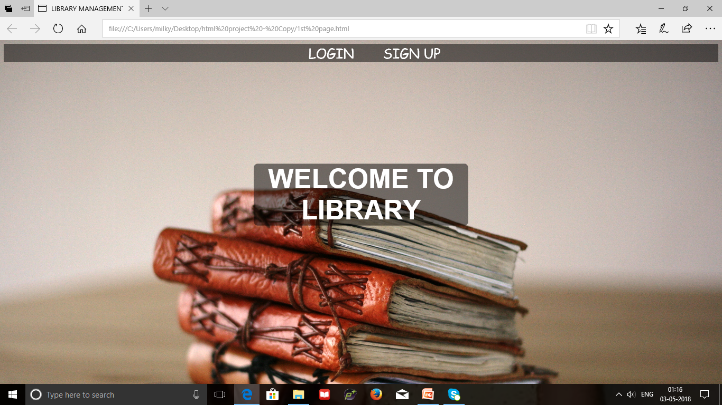
Homepage joining login and signup page

Slide 7
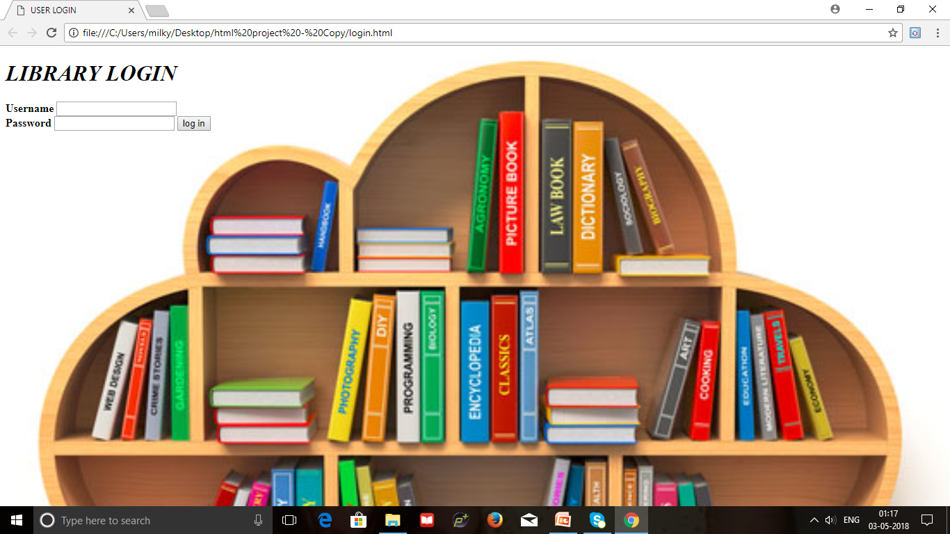
Login page

Slide 8
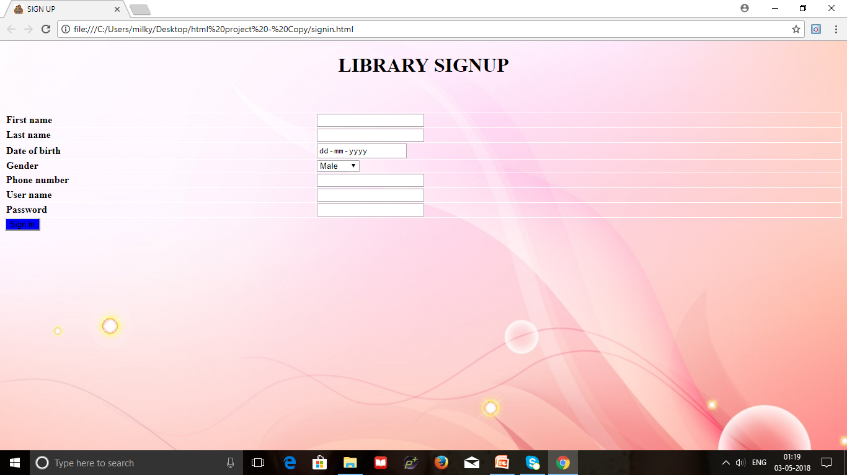
Sign up page

Slide 9
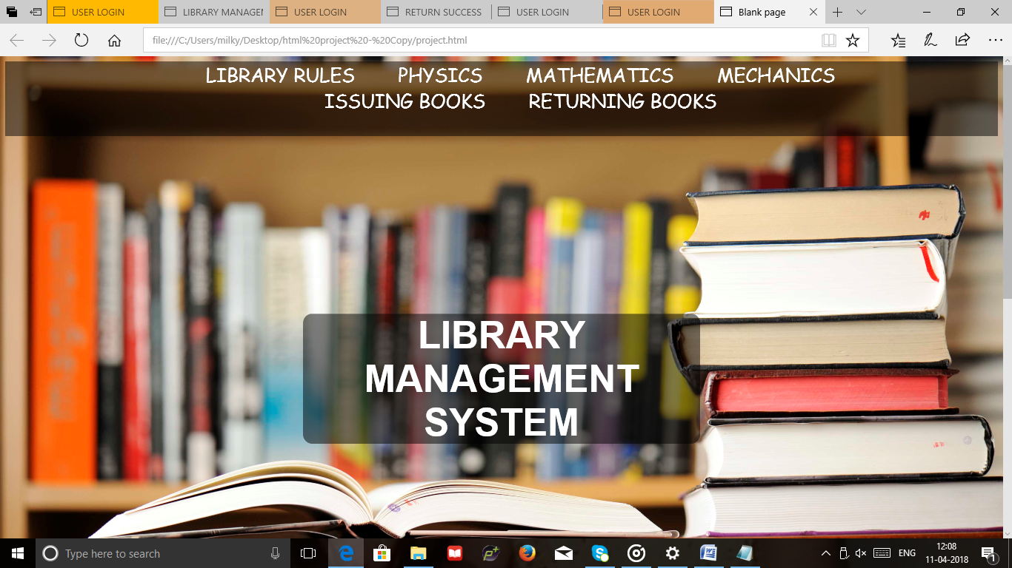
home page joining remaining pages

Slide 10
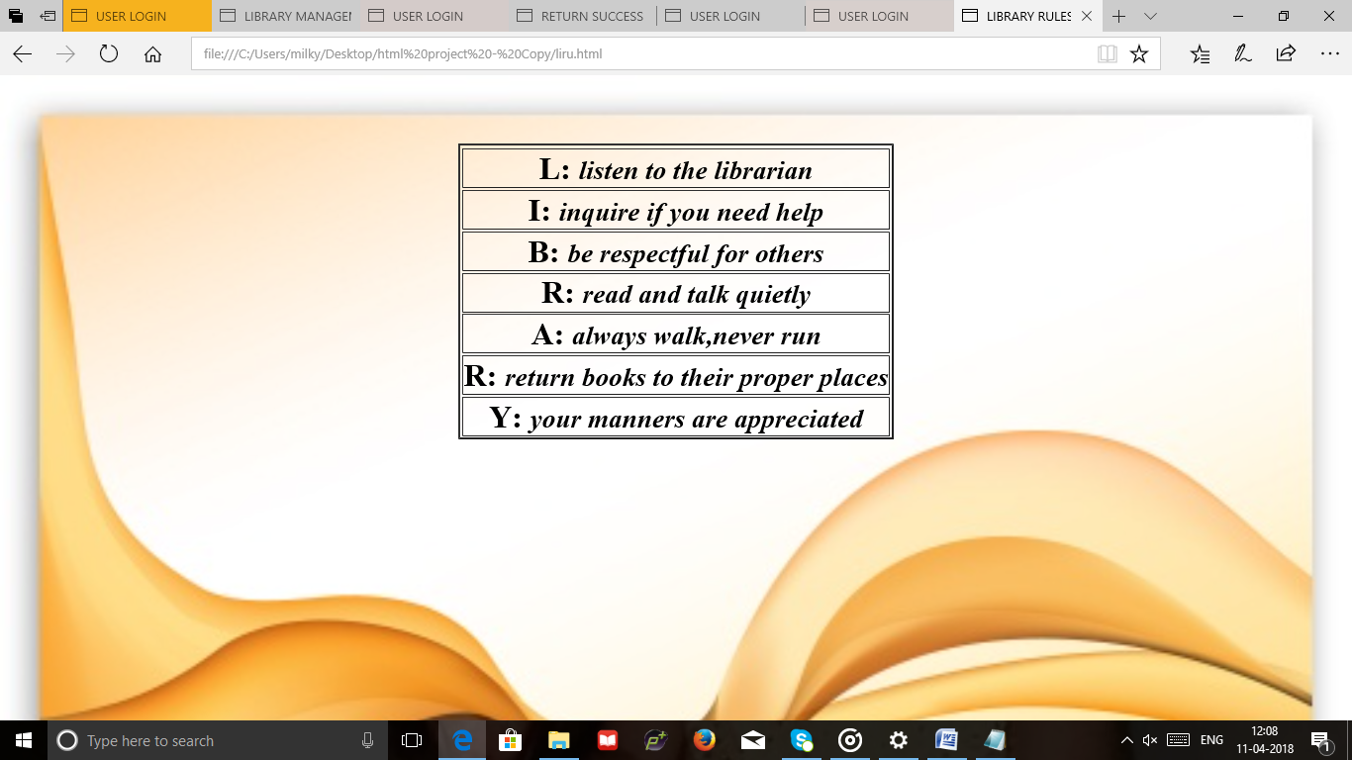
Library rules

Slide 11
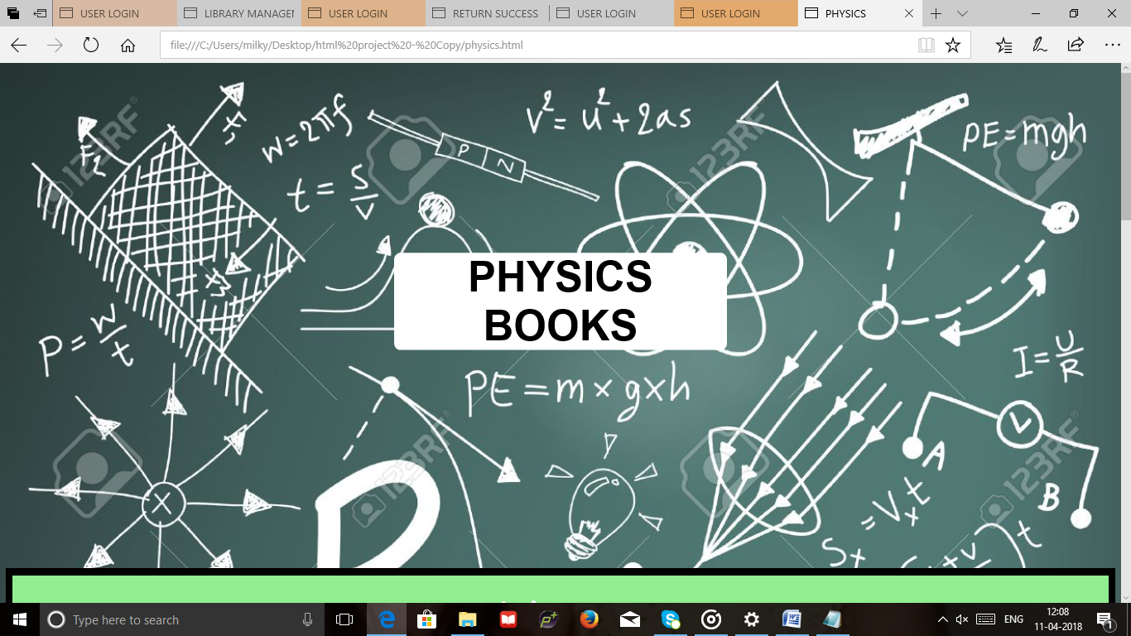
Physics page

Slide 12
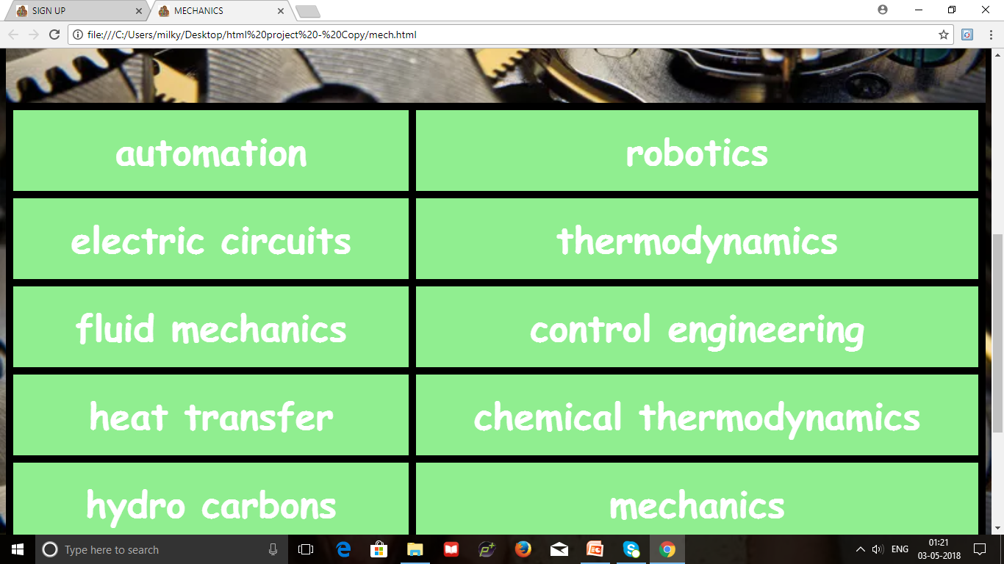
Mechanics page

Slide 13
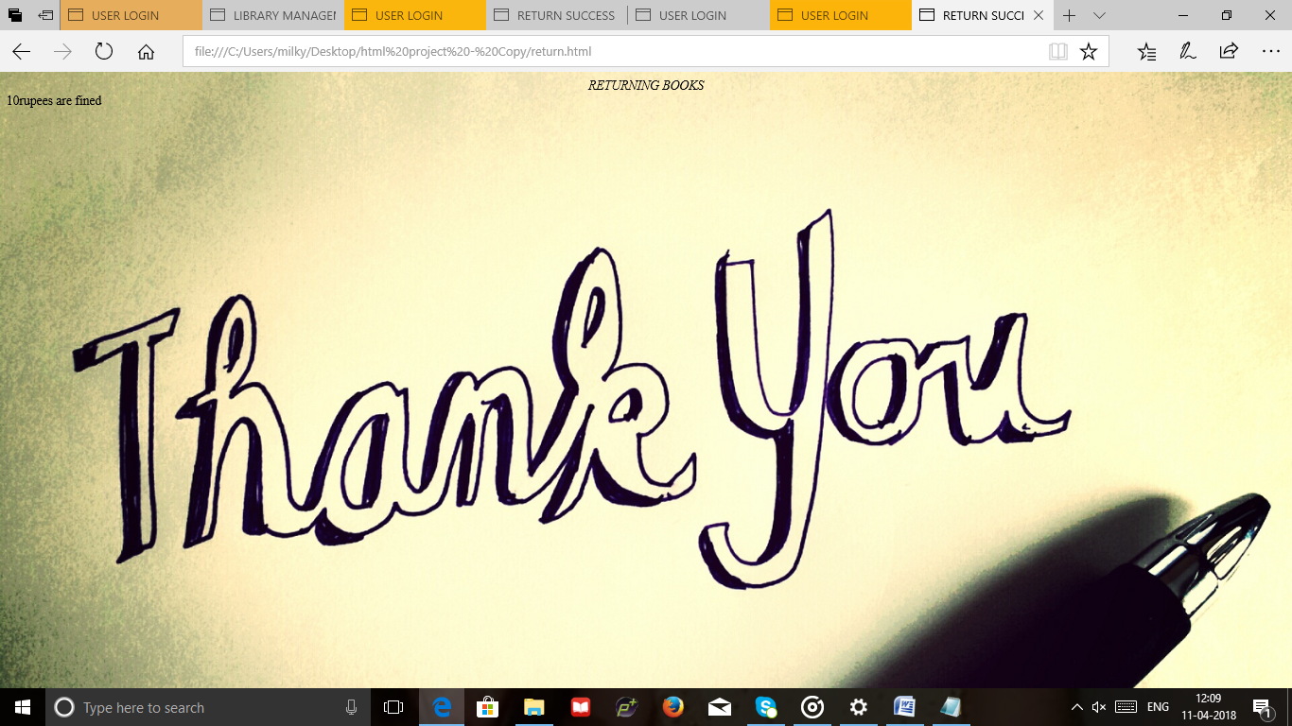
Return books page

Slide 14
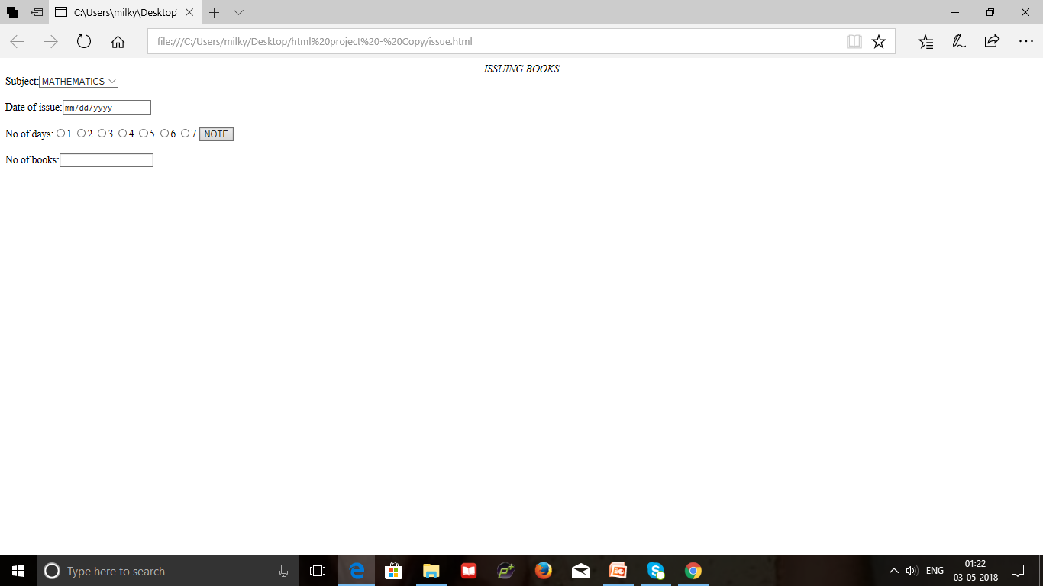
Issue books page

Slide 15
conclusion
From this project we are going to conclude that it is easy for students to access the books in library
The system had been developed using html, css and java script

